Slide 1

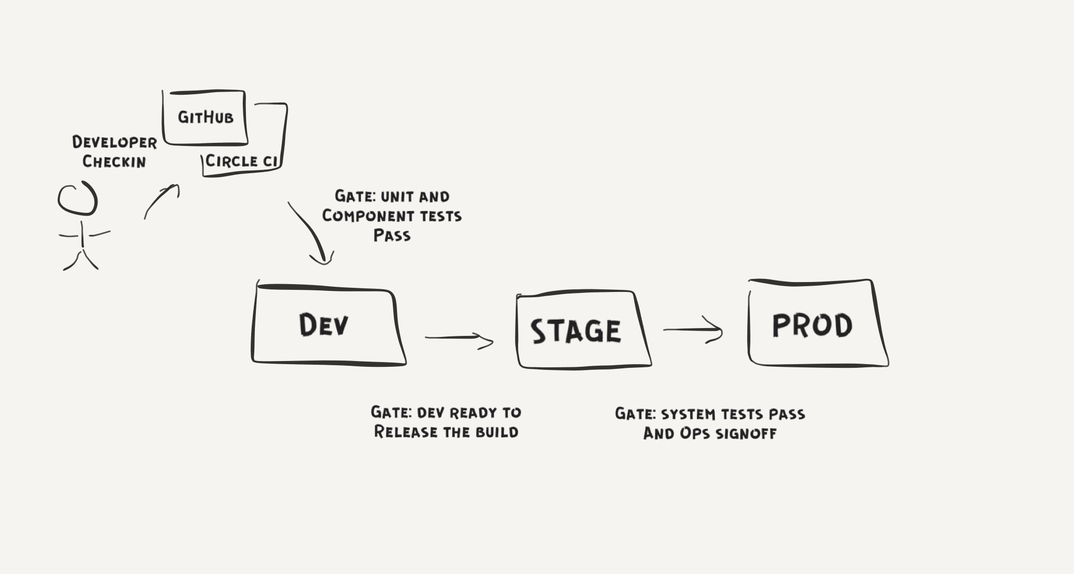
Agile, Continuous Delivery and DevOps ON Qlik Sense Cloud
Jim Reed
Software Development Manager
Qlik

Slide 2
Topics
- Introduction
- How we do Agile
Continuous Delivery
- Microservices
- Our approach to DevOps
- Things we’ve learned

Slide 3
introduction
Qlik is on a journey evolving from a monolithic enterprise product released three times per year, to a cloud first microservices based product deployed multiple times per day.
This presentation describes our approach to Agile, Continuous Delivery and DevOps on Qlik Sense Cloud. It discusses some of the impacts Continuous Delivery and DevOps have had on our Agile processes and shares some of what we’ve learned over the past two years developing Qlik Sense Cloud.
These slides are an early draft (combining a number of different presentations). More details/editing/organization to follow.

Slide 4
How we do Agile
Planning
Standups
Backlog Grooming
Pre-Planning
Demo/Review
Retrospective

Slide 5
Planning
Break into sub-teams
Each sub-team sets goal for the sprint
What are we going to demo at the end of the sprint?
Break stories into sub-tasks
Build a plan
Show and tell to the team

Slide 6
standups
Each sub-team:
Reiterate the demo goal
Are we going to make it?
Are we worried?
If we are worried, what are we going to do about it?
Does anyone need help?

Slide 7
Backlog grooming
Review top of backlog with stakeholders (epics)
Is the order correct?
Anything missing?
Agree on focus of next sprint

Slide 8
Pre-planning
Flush out stories for next sprint
Stories must have acceptance criteria
Must fit in a sprint
Must be sized
Must be able to explain it in enough detail to the rest of the team so we can size

Slide 9
Demo / Review
Show and tell to the team.
Review stories as a team to agree that they are done.

Slide 10
retrospective
What went well?
What could have been better?
What experiments do we want to try next sprint?

Slide 11
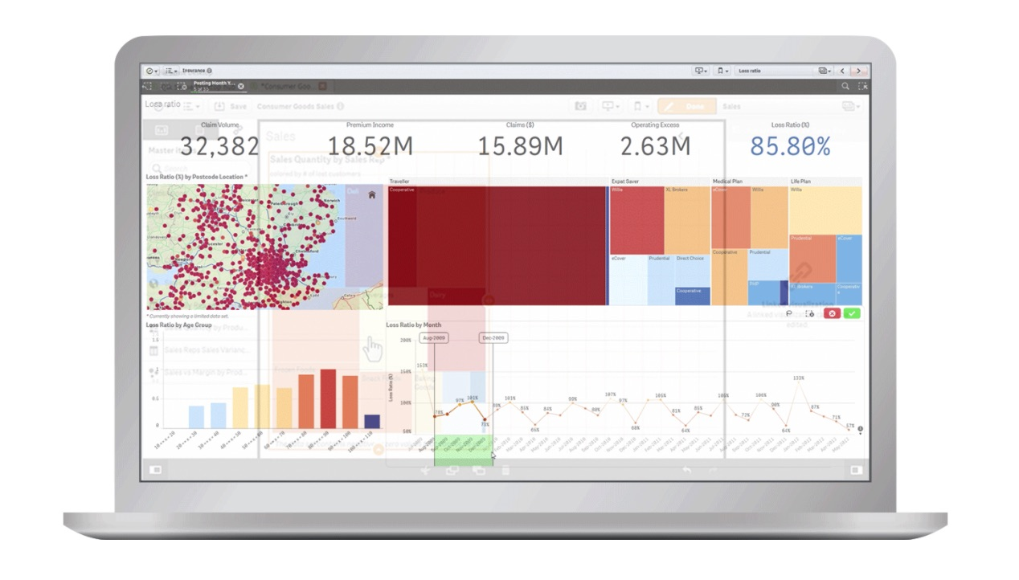
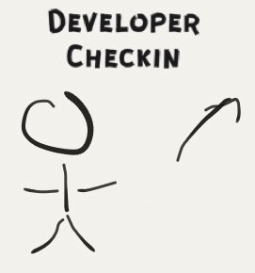
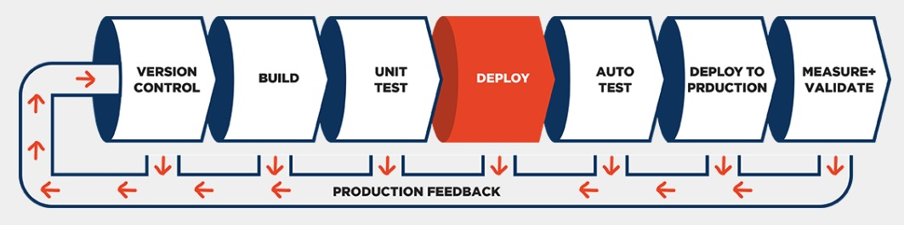
Continuous delivery
When a developer checks a change into master it can make it to prod later that day.

Slide 12
Continuous Delivery Pipeline
After check-in, testing occurs in multiple environments: Dev, Stage and Prod.

Slide 13
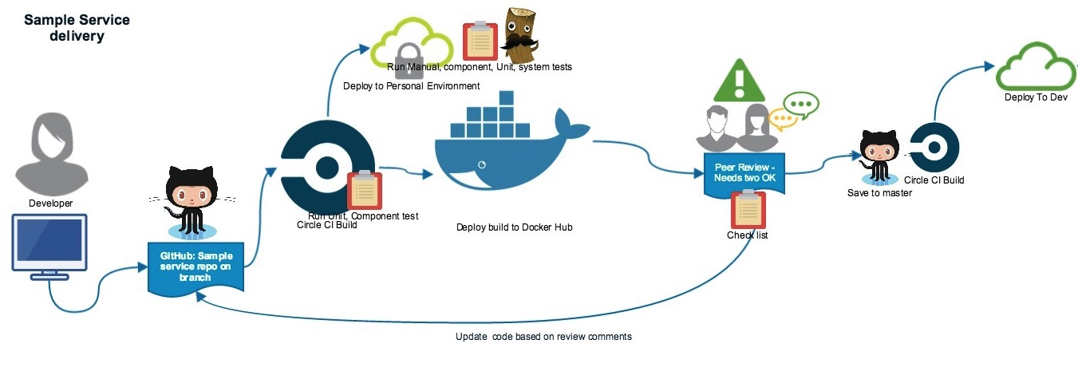
Before Merge to Master
Testing complete
Peer review complete
Automated tests included in PR
Ready for prod
If high risk, has a mitigation plan

Slide 14
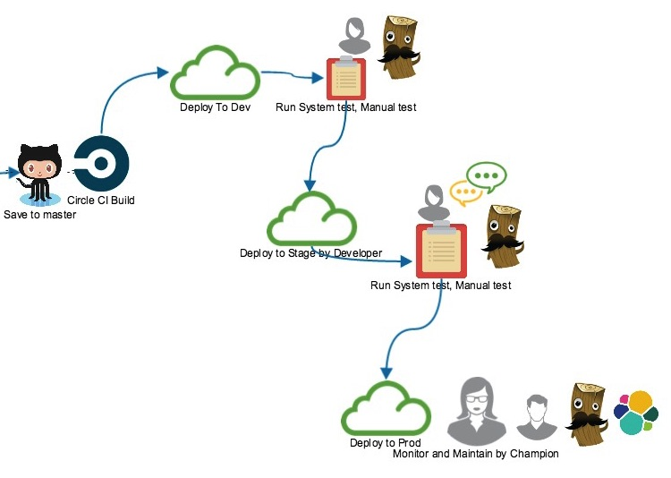
Ready For Dev?
Build successful
Unit tests, component tests and integration tests pass

Slide 15
Dev
Integration environment
Run system tests
Can run additional tests to confirm we are ready for prod

Slide 16
Ready For Stage?
System tests pass
No new regressions found
Dev team releases the build

Slide 17
Stage
Staging environment, just like prod
Rehearse /dry run prod deployment
Can run additional tests to confirm we are ready for prod
Practice rollback procedure

Slide 18
Ready for Prod?
System tests pass
Ops and QE sign-off
No outstanding issues

Slide 19
Deploy To Prod
Dev pairs with Ops to deploy to prod
Sanity test to verify deploy was successful
Dev and Ops monitor prod for issues
Gather evidence that change meets expectations

Slide 20
Microservices

Slide 21
Why microservices

Slide 22
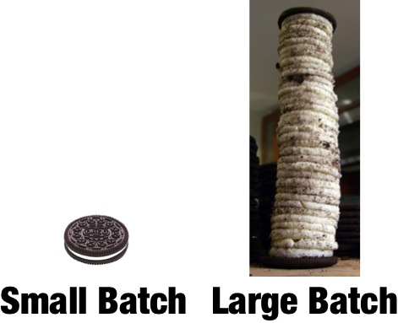
Benefit: More predictable releases
Switching to Continuous Delivery increased our release predictability. It is much easier to deploy small changes to prod. It’s easier to deploy without disruption. Don’t have to remember what you did two months ago. Don’t forget that extra deployment step.

Slide 23
Benefit: Better feedback
Quicker more focused feedback. Much easier to debug issues.

Slide 24
Benefit: Flexible
You get good at releasing if you do it every day. This really comes in handy when you have to deploy an emergency fix (or rollback) or quickly deliver a new feature. It’s pretty hard to rollback a month’s worth of code changes.

Slide 25
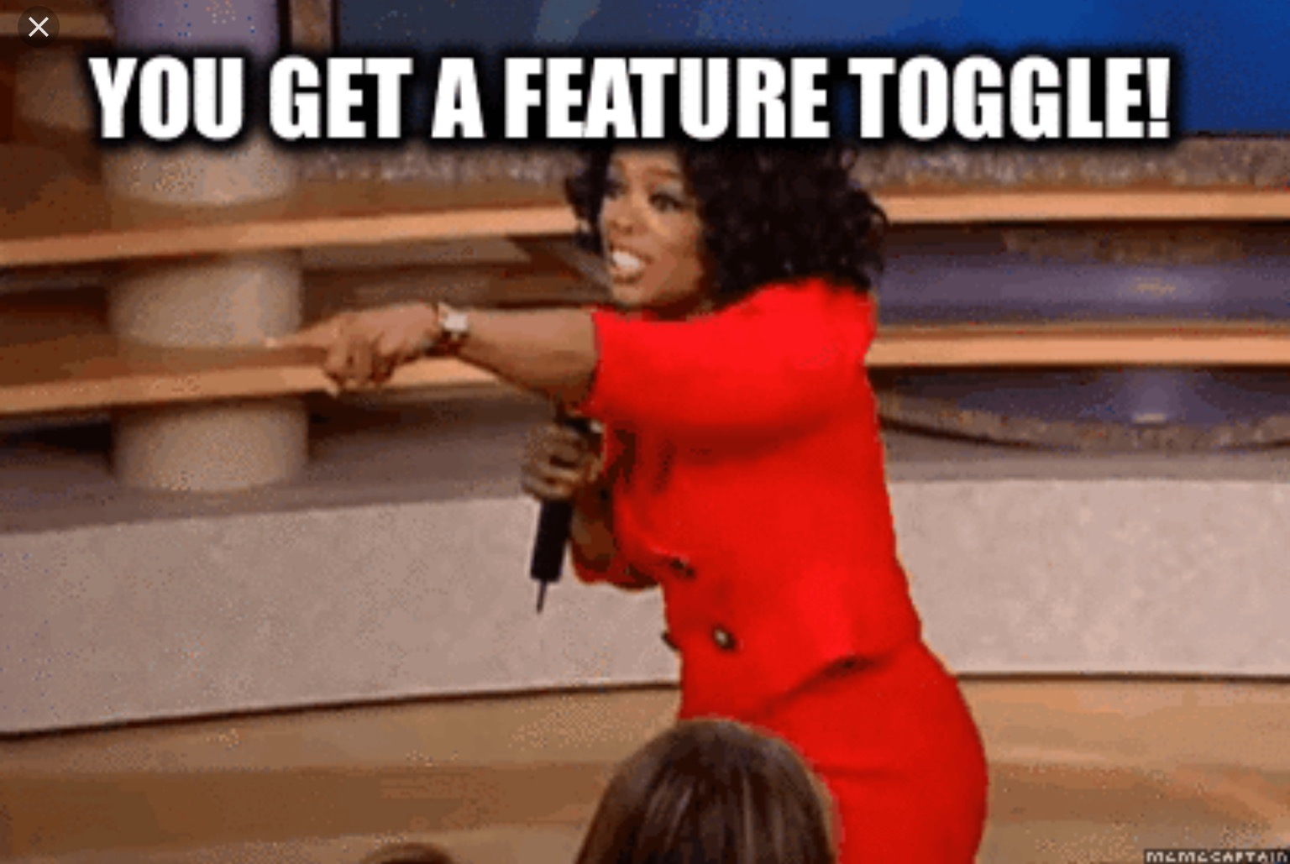
Feature flags
New features can be broken up into small pieces and delivered hidden under feature flags. Great to try things out in prod before your customers do. Great to make employees your guinea pigs.

Slide 26
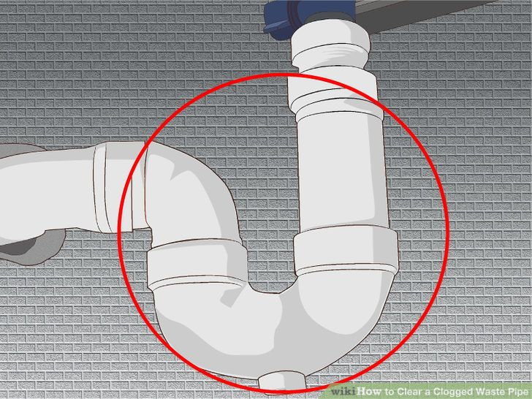
Challenge: Clogging the pipeline
Sometimes hard to have small changes, especially when refactoring. It’s especially hard when the changes have dependencies between services. These changes can clog the pipeline.

Slide 27
Our approach to devops
The processes, tools and strategies used to help build an effective partnership between development and operations and to support the delivery of awesome cloud products.

Slide 28
champions
Development microservice primes that work with ops and other developers to ensure we are successful in production.

Slide 29

Champions: History
2015
2016
Monolith Architecture
2 hr min to deploy on Friday night
~12 Developers
0 local Ops
Hard to understand and maintain
A few dev trusted with the task
Micro services
~15 Dev
1 local Ops
Dev owns dev/stage
Ops own prod
Quality is filtered by a few Devs
Much faster deployment but required Dev + Ops
Issues we experienced:
Too many services for a single Ops
Ops time spent deploying microservices, no time to do Ops work or monitor quality
Dev needed to take responsibility for pushing to Prod
Current approach not scalable for continuous delivery
Self-made bottleneck for deployments
We needed to re-think our approach to improve quality and to utilize everyone to the best of their abilities

Slide 30

Champions: what we learned
We realized that we were doing it wrong.
A microservice is a vertical slice and it requires deep knowledge
It requires a contact, a goto person
It requires good documentation
It is harder to monitor, requires custom logs, metrics
Sometime, it gets sick
Sometime, it does not play well with others
IMPORTANT: The experts are the people who created it

Slide 31
Things we’ve learned

Slide 32

When is a story done?
A) merged to master
B) deployed to develop
C) deployed to production
D) verified in production

Slide 33
When is a story done?
A) merged to master
B) deployed to develop
C) deployed to production
D) verified in production

Slide 34
Getting it working is 25% of the work
There is a lot of production hardening work to do after you get your feature working.

Slide 35
Rolling 5 Beat Plan
Update every sprint to make sure it doesn’t turn into a 4 then 3 beat plan.

Slide 36
Physical Scrum Board
We use a calendar view to validate/challenge our plan. We look for early wins and de-risking the sprint.

Slide 37
Sprint Predictability
One of our team goals is to improve our sprint predictability. Increased focus on planning and tracking velocity been a big help to our team.

Slide 38
thanks

